Slide 1
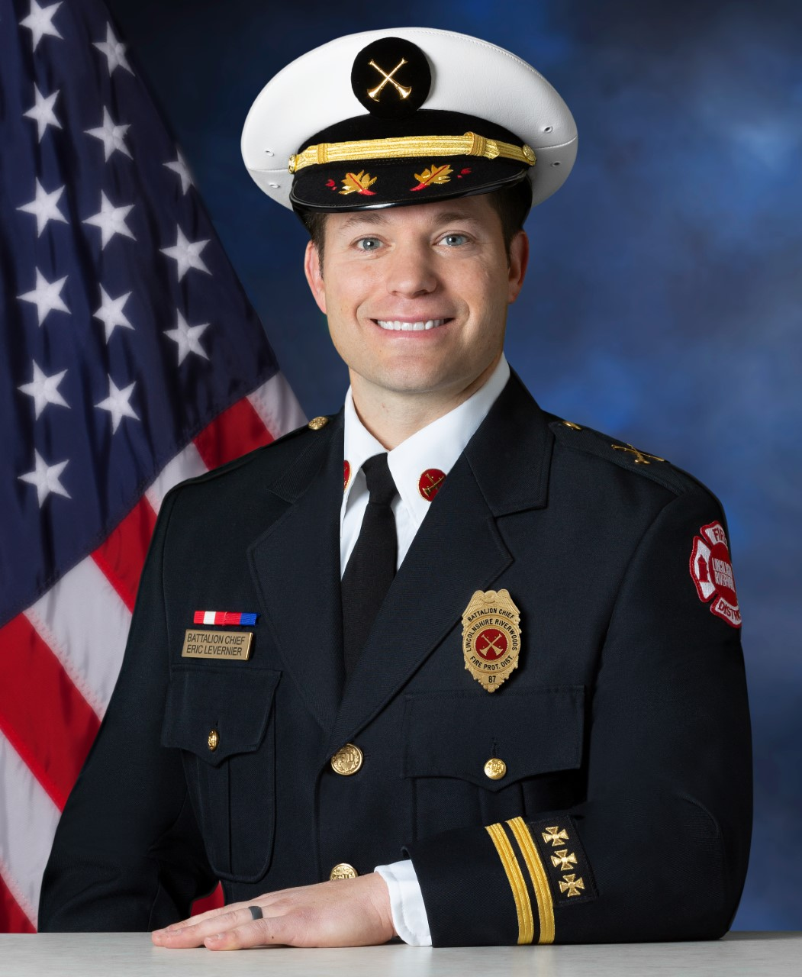
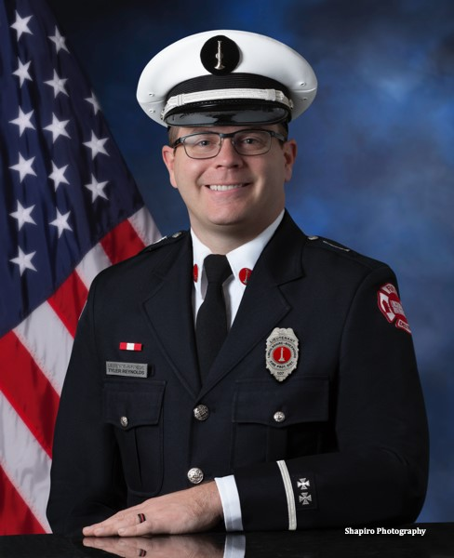


Lincolnshire-Riverwoods fire protection district
Officer and Firefighter of the year (2021) ceremony may 18th, 2022 5 p.m. station 51
Officer of the Year
Firefighter of the Year
Battalion Chief Eric Levernier
Lieutenant
Tyler Reynolds

